Slide 1
Community Advisory Board
Toni Kuhlman
Advisory Board Chair

Slide 2
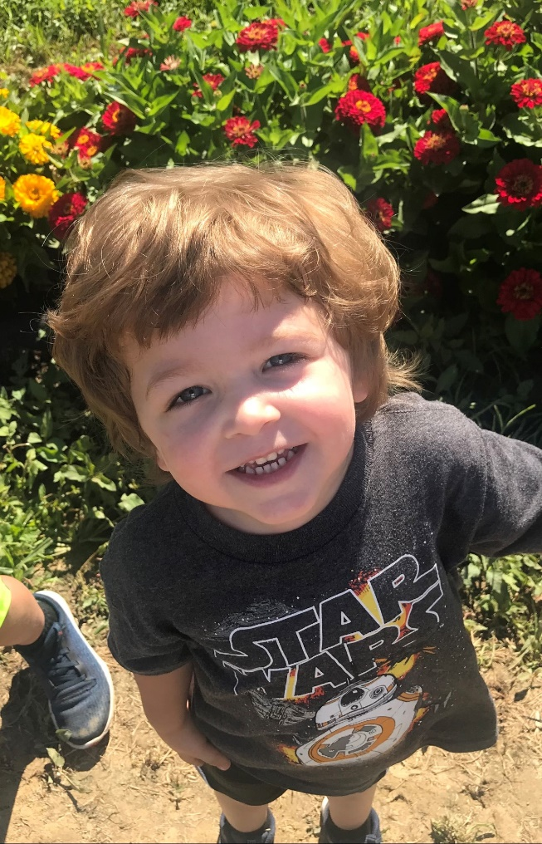
Background: Then
Diagnosed in March 2014, 61 years old
No symptoms
Chance accident led to x-ray (thanks to this guy )
Stage IIIB non-small cell adenocarcinoma of the lung at diagnosis (right lung & lymph nodes)
Found hope in the Barrett Center after initial grim diagnosis elsewhere
Radiation, chemo, surgery to remove 30% of my lungs, clinical trials, hair loss, nausea, etc. – it’s not an easy road but you have to stay positive and lean on support system!

Slide 3
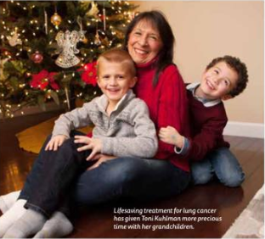
Background: Now
4.5 years after diagnosis
Stage IV at present, after spread to knee, pelvis, & left lung
Currently on break from treatment after 20 months of continuous chemotherapy
Lingering side effect of vertigo (since June 2017) due to destroyed nerve in ear that controls balance, a side effect of chemo
Current overall prognosis is great – thanks to Drs. Barrett, Morris, & Starnes - & UCCI!

Slide 4
What is the Lung Cancer Community Advisory Board?
Group consists of volunteers and folks from UC passionate about raising funds for UCCI
Group meets regularly to plan and brainstorm fundraising that can benefit UCCI
Funds raised can drive research so desperately needed for new treatments and, hopefully, a cure!

Slide 5
Board Members
Toni Kuhlman, Chair
Thomas H. Bergman, ESQ
Shannon Dunn
Michele Roll
Jeff Schrand
Tera Winther
Clara Kuhlman
Liz Cole
Erin Hart
Laureen McCorkle
Dr. John Morris
Dr. Sandra Starnes

Slide 6
Mission and Priorities of the Board
Serve as advocates of UCCI Comprehensive Lung Cancer Center
Help increase visibility of the UCCI lung cancer program in our community
Contribute to the strategic planning process of the Comprehensive Lung Cancer Center
Assist in the fundraising efforts for the lung cancer center by attending center events and making key community connections

Slide 7
My Personal Goals for the Board
Raise awareness of lung cancer statistics, lack of funding for research & treatment
Raise awareness of lung cancer screening given it’s potential to increase survival
Educate families, friends, caregivers of those diagnosed with lung cancer – help give them the tools to support their loved one and find support for themselves as well
Recruit more members!

Slide 8
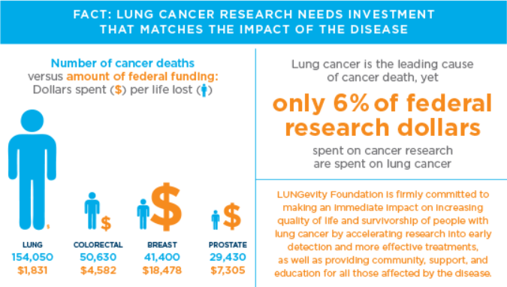
Why Lung Cancer Fundraising is so Vital
So important because lung cancer, in particular, impacts so many:
1 in 16 Americans will be diagnosed in their lifetime
60 – 65% of new lung cancer diagnoses are among people who have never smoked or are former smokers
Accounts for 25% of all cancer deaths
More lives lost to lung cancer than to colorectal, pancreatic, breast, and prostate cancers combined
Source: longevity.org

Slide 9
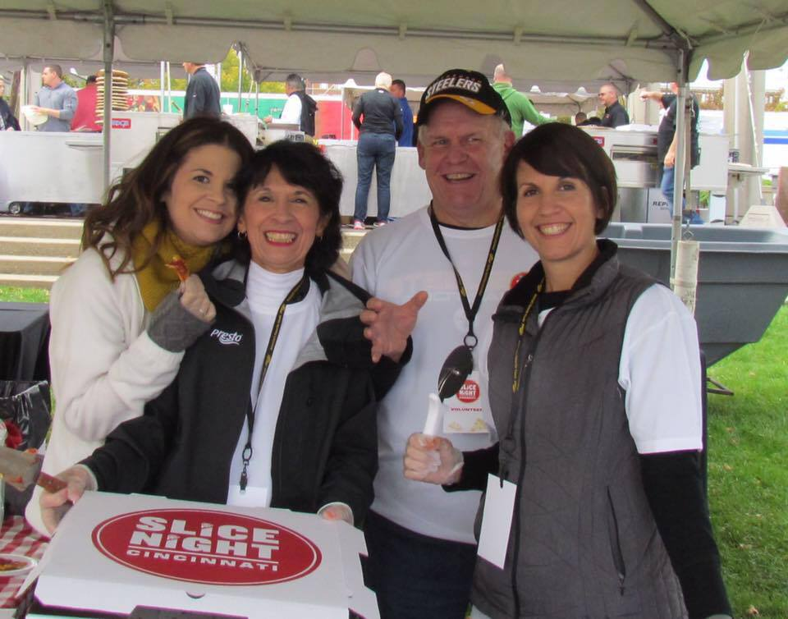
Slice Night!
Top fundraising event for the board
2018 was 5th year
Presto/PFG & Cincinnati Magazine sponsor
2018 raised $37k
Event growing annually – has raised $150k in 5 years!

Slide 10
How Can You Help?
Always looking for new fundraising ideas, volunteers, and leaders
Want to build on/revive Shannon Dunn’s past Lungs on the Run success
Contact us to get involved!
Toni Kuhlman toni.kuhlman@yahoo.com
Erin Hart harte2@ucmail.uc.edu

Slide 11
Thank you! ☺
Dr. Barrett
Dr. Morris
Dr. Starnes
UC Staff Members

