Slide 1
Lung Cancer Screening
Sandra Starnes, MD
Professor of Surgery
John B. Flege Chair in Cardiothoracic Surgery
Co-Director, Lung Cancer Center

Slide 2
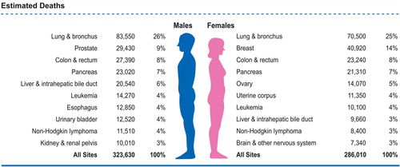
Lung Cancer Facts
Lung Cancer is the #1 cancer killer in the US
Cancer statistics, 2018, Volume: 68

Slide 3
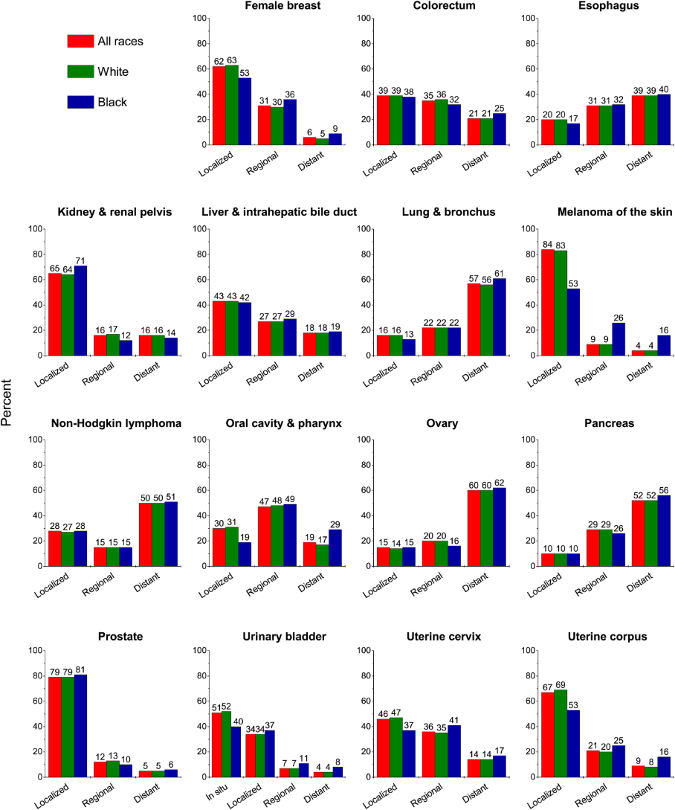
Lung Cancer Facts
Most patients diagnosed with advanced disease
Stage at diagnosis
Cancer statistics, 2018, Volume: 68

Slide 4
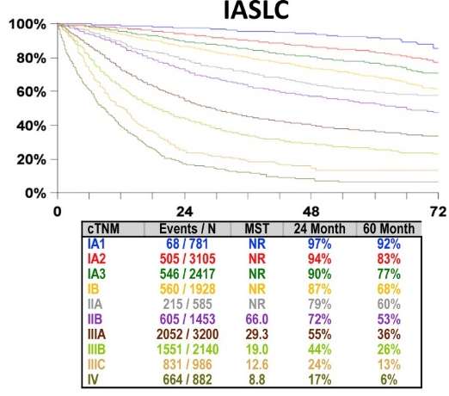
Lung Cancer Facts
Lung cancer is curable when diagnosed early
Journal of Thoracic Oncology 2017 12: 1109-1121

Slide 5
Lung Cancer Screening
What is screening?
  A test done to detect a cancer before symptoms develop
  Symptoms of lung cancer typically do not appear until the disease is advanced
Why hasn’t lung cancer screening been routine?
  Until recently, there hasn’t been an effective test
  Lung cancer screening with CXR showed no benefit
    No change in lung cancer deaths

Slide 6
National Lung Screening Trial
Large clinical trial 2002-2007
Over 50,000 patients at risk for lung cancer
  55-74 years old
  Current or former smokers
Randomized to annual low-dose CT scan to CXR
New England Journal of Medicine August 4th, 2011

Slide 7
National Lung Screening Trial
People who got low-dose CT scans had a 20% decreased risk of dying from lung cancer
  320 people need to be screened to prevent 1 lung cancer death
    1339 for breast cancer
  More cancers detected at an early stage
First time that lung cancer screening has been shown to decrease lung cancer deaths!
Results announced in 2010
New England Journal of Medicine August 4th, 2011

Slide 8
Who Should Get Screened?
Age 55-80
Current or former smoker
>30 pack year smoking history
  Packs per day X years smoked
  1 pack per day for 30 years or 2 packs per day for 15 years
No symptoms of lung cancer
  New or changing cough
  Coughing up blood
  New or increasing shortness of breath

Slide 9
What is the Benefit of Screening?
Detection of lung cancer early when it is curable
Decreased chance of dying from lung cancer
7 million Americans estimated to be eligible for lung cancer screening
  Could potentially save 22,000 lives
Estimated that <4% have undergone screening!

Slide 10
What are the Risks?
False positives
  Finding a nodule (spot) that is not cancer
  Most nodules (95%) seen on CT are not cancer
  May require additional testing
False negatives
  A negative screening CT does not mean you don’t have lung cancer or can’t get lung cancer

Slide 11
What are the Risks?
Radiation exposure
  Low-dose CT ~ 20-25% of standard CT
  Similar to 12 CXRs
  Similar to 6 months of natural background radiation
Costs
  Most insurance companies cover lung cancer screening
  There may be cost for additional CT scans and testing for positive results

Slide 12
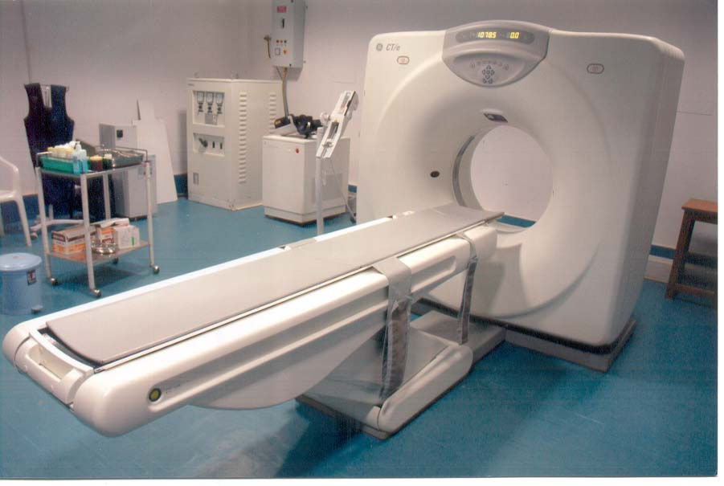
What to Expect
Low-dose CT
  No IV or dye used
  Scan completed in under a minute

Slide 13
What do the Results Mean?
Negative screen
  No nodules (spots) seen and no other abnormalities
  Annual low-dose CT scan
Positive screen indeterminate for lung cancer
  A nodule (spot) was seen
  About 50% of patients will have at least one nodule
  Most of these spots are NOT cancer
Positive screen suspicious for lung cancer
  Further testing or biopsy may be recommended

Slide 14
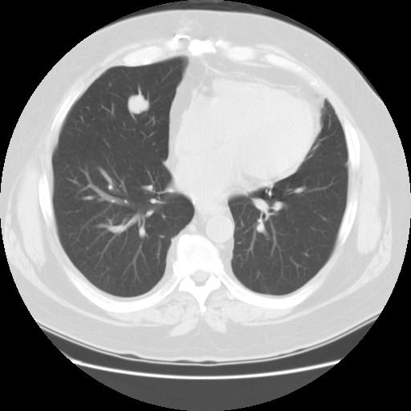
What do the Results Mean?

Slide 15
What do the Results Mean?
What if I have a nodule (spot)?
We may recommend:
  Follow up scan in 3-6 months
  Further testing such as a PET scan
  Referral to a lung specialist for possible biopsy

Slide 16
Insurance Coverage
Annual screening with low-dose CT covered
Private insurance
  Age 55-80
  >30 pack year smoking history
  Current smoker or quit within 15 years
Medicare
  Age 55-77
  >30 pack years smoking history
  Current smoker or quit within 15 years
  Shared decision making visit

Slide 17
UC Health’s
Lung Cancer Screening Program
First program in the region
  Started November 2012
Lung Cancer Alliance Screening Center of Excellence
Screening locations
  UCMC
  UC Physicians Office North West Chester
  Daniel Drake Center

Slide 18
UC Health’s
Lung Cancer Screening Program
Eligibility
  Age 55-80 and
  30 pack year smoking history
  No symptoms of lung cancer

Slide 19
UC Health’s
Lung Cancer Screening Program
Personalized care from dedicated screening team
Mona Hemingway, BSN, RN, PCCN
  Program Manager
Robert Simmons
  Clinical Services Coordinator

Slide 20
UC Health’s
Lung Cancer Screening Program
Specialized Lung Cancer Team with expertise in lung cancer and lung cancer screening
  Thoracic surgeons
  Medical oncologists
  Radiation oncologists
  Chest radiologists
  Interventional pulmonologists
  Pulmonary pathologists
  Oncology nurses and nurse practitioners

Slide 21
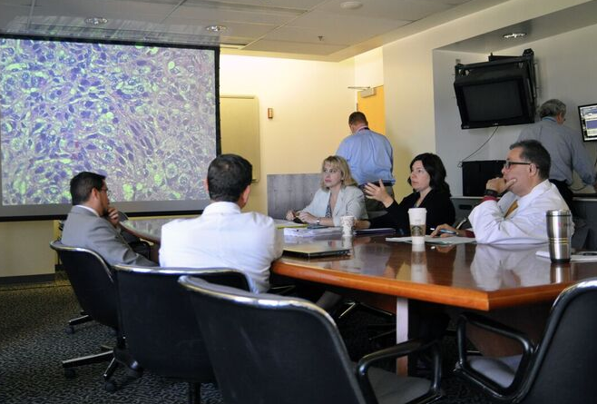
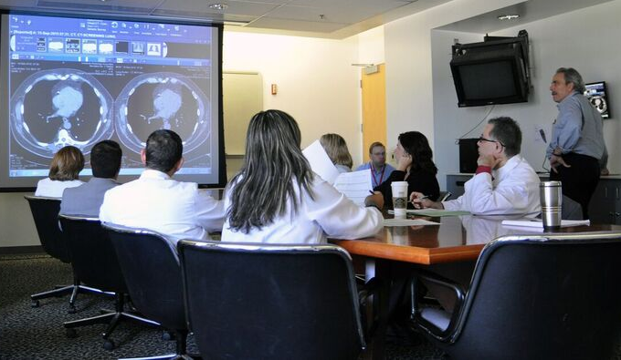
UC Health’s
Lung Cancer Screening Program
Lung cancer team meets weekly
  Discuss abnormal screening results
  Provide personalized approach for patients

Slide 22
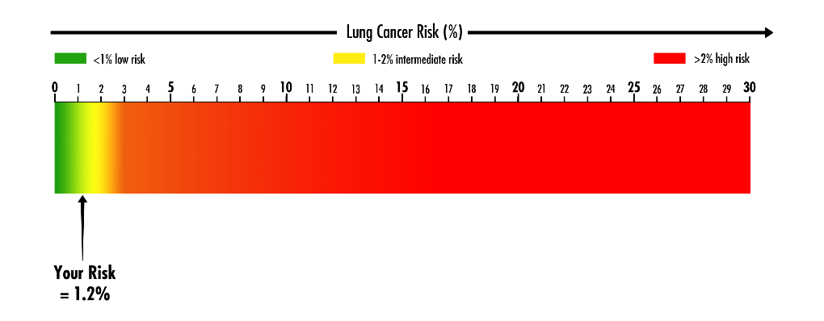
Lung Cancer Screening
Future Directions
Risk prediction models
  Include risk factors other than age, smoking history
  Better determine who should be screened
Blood test to determine increased risk

Slide 23
Summary
Lung cancer screening with low-dose CT decreases deaths from lung cancer
Screening is not appropriate for everyone
  Only shown to be of benefit for those at higher risk of lung cancer
Lung cancer screening should be done in structured programs experienced in lung cancer
Screening is not a substitute for quitting smoking

Slide 24
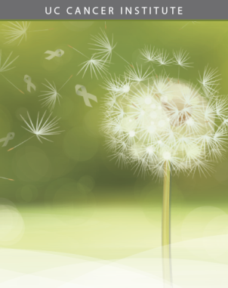
Hope! Fight! Breathe!

